Slide 1
“Computers in the future may weigh no more than 1.5 tons.”
—Popular Mechanics, 1949

Slide 2
Predictive Analytics
What will happen in the future?
Time series approaches
Multivariate approaches

Slide 3
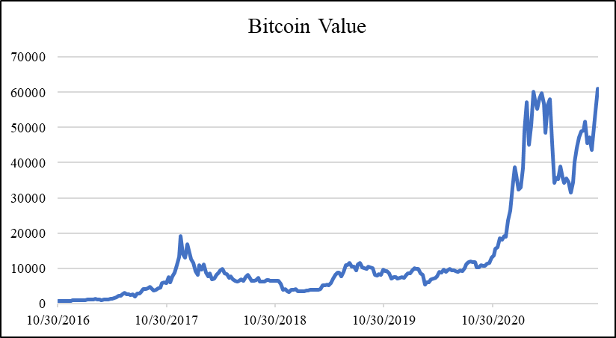
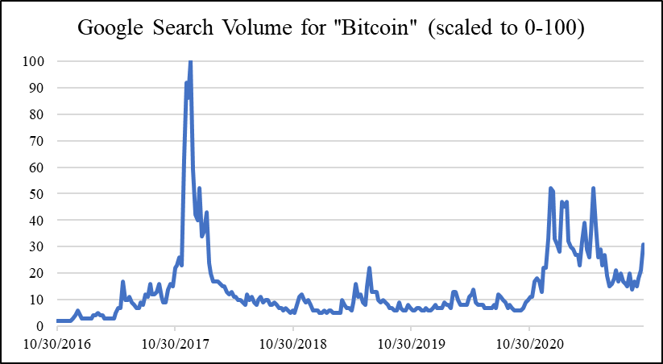
Forecasting
Forecasting: making a prediction for a variable based on historical observations
Methods range from very simple to extremely complex

Slide 4
Forecasting
4
3
Sales
($M)
?
2
1
Time
1
2
3
4
5
6
7

Slide 5
Moving Average (Three-Period)
4
Actual data
Average of these three data points
Predictions
3
Sales
($M)
2
1
Time
1
2
3
4
5
6
7

Slide 6
Moving Average Definition
The k-period moving average for some period t is given by:
That is, the moving average for a period is the average of the preceding k periods

Slide 7
Moving Average
Moving averages are simplistic; unlikely to give the best predictions
However…
Better than taking an average over the entire time series
Emphasizes recent data
Better than relying on only the most recent data point
Incorporates multiple data points

Slide 8
How Accurate?
Several metrics; most common is mean squared error (MSE)
Can compute it in Excel or R
There are others; all are aggregates of how close our forecasts were to the actual data points
Mean absolute percentage error (MAPE): if the proportion of the error is more important than magnitude
Mean absolute deviation (MAD): less influenced by outliers
Mean forecast error (MFE): should be close to zero; if it’s not, suggests a possible bias in the model

Slide 9
Mean Squared Error
If our three forecasts were: 15, 18, 20, and in those periods we observed: 20, 22, 19,
Our mean squared error would be: ( (15 – 20)² + (18 – 22)² + (20 – 19)² ) / 3 = ( (–5)² + (–4)² + (1)² ) / 3 = (25 + 16 + 1) / 3 = 42 / 3 = 14

Slide 10
Exponential Smoothing
More rigorous and accurate (generally), but less intuitive
Each forecast is a weighted average of the previous data point and the previous forecast
Incorporates every previous data point into each forecast, with more emphasis on more recent data
Notes:
Use existing video

Slide 11
Exponential Smoothing: Weights
Exponential smoothing formula:
Smoothing constant
Damping factor
Notes:
Use existing video

Slide 12
Exponential Smoothing (α = 0.5)
Sales
($M)
Actual data
4
Predictions
3
2
1
1
2
3
4
5
6
7
Time
Notes:
Use existing video

Slide 13
α = 0.8: MSE = 147
α = 0.2: MSE = 198
Notes:
Use existing video

Slide 14
Numerical Example
Data | Forecasts (α = 0.4)
10 | -
5 | 10
18 | 0.4*5 + 0.6*10 = 2 + 6 = 8
12 | 0.4*18 + 0.6*8 = 7.2 + 4.8 = 12
7 | 0.4*12 + 0.6*12 = 4.8 + 7.2 = 12
16 | 0.4*7 + 0.6*12 = 2.8 + 7.2 = 10
 | 0.4*16 + 0.6*10 = 6.4 + 6 = 12.4

Slide 15
Exponential Smoothing in R
See Forecasting.R script
“ts” function converts a vector of data into a time series
Use the “HoltWinters” function native to R
Can be used for exponential smoothing by setting the beta and gamma parameters to FALSE
There are many R packages for dealing with time series, such as forecast, smooth, and xts

